Slide 1
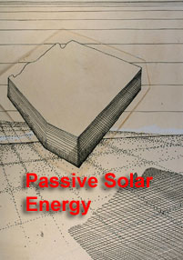
Passive Solar Energy
Primer
Arizona Solar
Center
Revised: 2015

Slide 2

The sun’s energy is an incredible bounty. The energy contained in solar rays make their way through our filtering atmosphere and is critical to life on this planet...

Slide 3


and is fundamental to human survival. It can also provide for our comfort.
The use of the sun’s power in solar energy design is usually identified in 2 contexts - Passive Solar - that which uses natural processes without mechanical equipment and additional electrical or gas energy to operate, and Active Solar - that which uses nature’s resources with the inclusion of mechanical equipment and hardware driven by electricity and gas.

Slide 4
All solar design starts from a simple base - Passive Solar First.
Passive solar applies both to buildings and equipment.

Slide 5
Sound fundamentals of good passive applications and integration can beneficial and are directly related to active solar equipment use and implementation:
1. by meeting needs with no mechanical equipment dependent on external energy incorporation,
2. in improving conditions which reduce the amount and size of equipment required to meet needs,
3. by improving the conditions for active solar equipment applications, and
4. in minimizing the commensurate costs that accompany the purchase and use of any equipment, solar or non-solar.

Slide 6
Passive solar actions can result in the reduction of quantity of equipment needed to meet a particular task. For example, daylight is an available resource to meet illumination needs. Good day lighting design of buildings uses that resource effectively, and reduces the need and cost of daytime artificial lighting and equipment.
Quite simply, the less work that needs to be accomplished by equipment, the less amount of equipment is needed, and the less it needs to run when used.

Slide 7
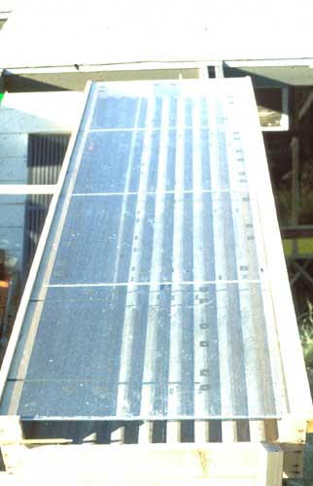
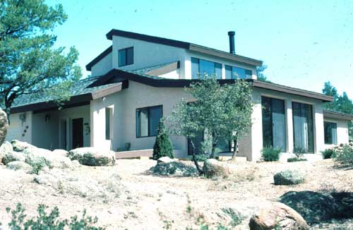

Slide 8
Traditionally, the term Passive Solar has been identified with heating and cooling of buildings, but it has a broader context and application.
Knowledge and understanding of natural processes is the heart of Passive Solar. Knowledge about the composition, attributes and behavior of sunlight and heat; the behavior of heat flow; the behavior and capacities of materials, both in nature and man-made; the sun’s annual, seasonal, and daily movement; diurnal and seasonal temperatures and conditions; human sensory response and comfort ; the patterns of nature and of people; and the physiology and psychology of the interaction between people and Nature, all are applied to effective solar application and utilization.

Slide 9
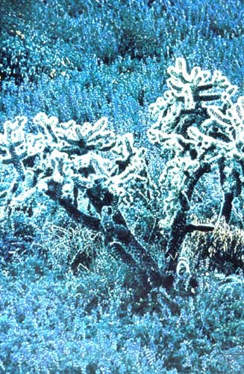

The conditions that nature provides, in the form of climate, is variable. Cold in the winter, hot in the summer, nice other times of the year.

Slide 10


Arizona climate covers the entire spectrum with extremes at the desert and mountain locations.
Simultaneously, nature also provides the tools for mitigation of the extreme conditions. Sunlight and materials for a warming system; breezes, water, earth, gravity, and materials for a cooling system. It is the application of these resources into a system that addresses conditions that makes passive, and active, solar so effective.

Slide 11
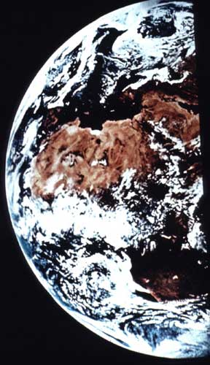
We know the sun’s position every day of the year and the amount of radiation that position provides, both to the earth’s surface, as well as to various positions of building walls and/or equipment.

Slide 12
A south facing wall, or piece of equipment gets more energy from the sun than any other position. An angle directly perpendicular to the sun gets more energy per square foot than one that is at an angle. The sun is less available in the winter (shorter days) than in the summer. There is less solar energy availability in the winter than the summer due to the sun’s position at an angle to the earth and therefore more atmosphere to penetrate.
We also know that cool air settles and warm air rises, and that this action occurs with fluids like water. We know about heat flow and capabilities of materials in their capacity to absorb, hold, and give up heat. We know how to let sunlight in, how to capture and create air movement for cooling, and prevent unwanted heat.

Slide 13
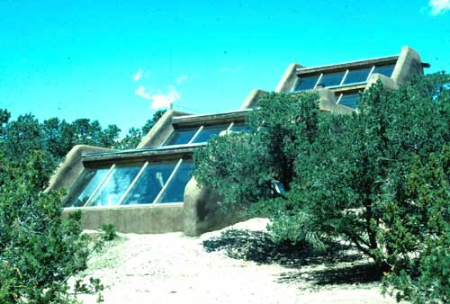
THE BUILT ENVIRONMENT IN TUNE WITH NATURE
Passive solar buildings are environmentally responsive and use nature’s elements in providing shelter and comfort to people; are non-depleting of natural resources; and use the building itself in the comfort creating process. They are characterized throughout the recent years with terms as “sustainable”, “renewability”, and “green”.

Slide 14
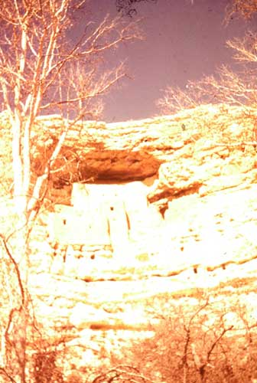
HISTORY
Arizona history is replete with examples of people living with the sun - both in using it as a resource as well as dealing with it’s negatives. While incorrectly called Arizona’s first solar building, the construction of Montezuma’s Castle does embody some solar principles of orientation, thermal mass, “overhangs” for summertime shading, and south facing winter courts.

Slide 15
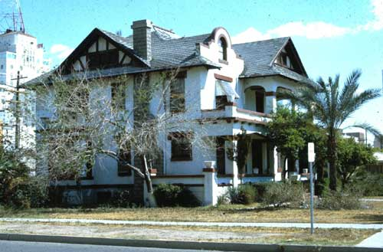
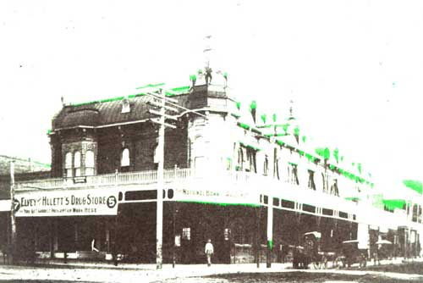
Desert buildings used proper orientation, thick masonry walls, natural cross ventilation, indoor and outdoor living spaces, and natural and man-made shade for summer cooling, and warmth during winter conditions.
Higher elevations of Arizona utilized the similar principles with differing amounts of wall mass and windows for heating, and porches and cross ventilation for summer evening relaxation and sleeping.

Slide 16
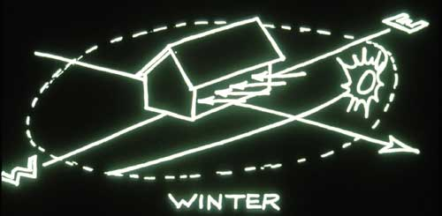
PASSIVE SOLAR ENERGY - PRELUDE TO SOLAR EQUIPMENT CONSIDERATION.
There are a number of passive energy fundamentals which can be considered in reducing the amount of equipment and/or its’ operation.
ORIENTATION - It’s a necessary thing...

Slide 17
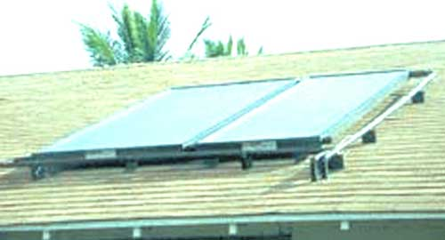
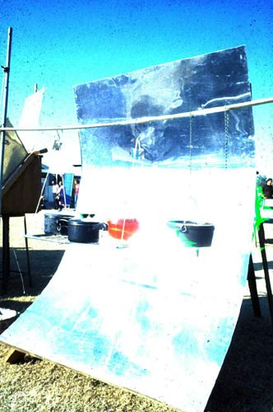
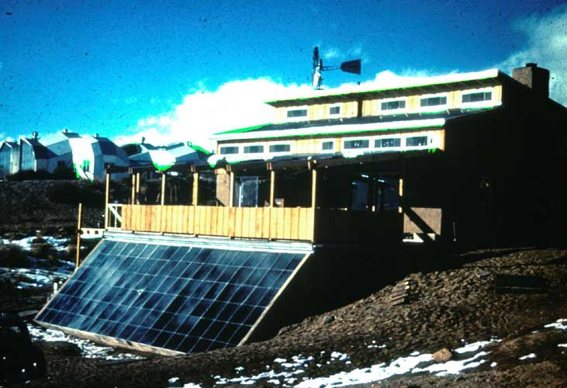
Like all direct solar applications, capturing the sun as a resource is as simple as providing for its clear path to where it can do its work - be it heating water, cooking food, or warming a space.

Slide 18
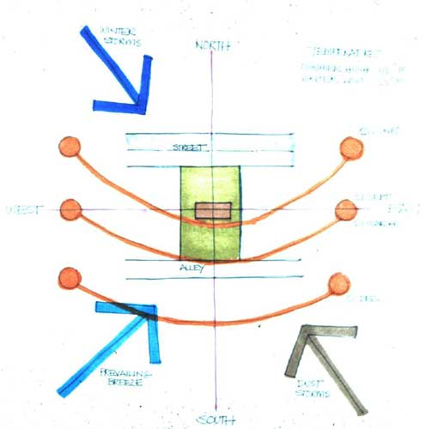
Orientation and a direct relationship with the sun is the first rule of solar energy use when trying to capitalize on its heat providing attributes.

Slide 19
Applied knowledge of both the sun’s movement, position at any given time, and time of the year, as well as impact in the form of radiation, enables us to take advantage of these attributes to meet our needs.

Slide 20
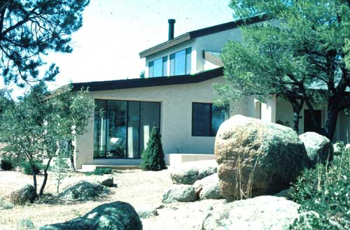
Proper building orientation also eases the integration of active solar equipment into the building form and shape, and mitigates the conflicts of solar installations contested in numerous subdivisions regulations.

Slide 21
Proper orientation with direct exposure to the south, is best for passive solar heating of building spaces as well as the operation of solar equipment (water heaters, pv panels, cookers, pool panels, etc.).
Slight adjustments to the east or west of south allow for earlier or later use of the sun's energy, or for mitigating it.

Slide 22
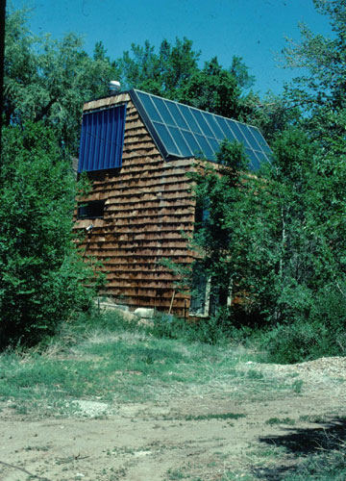
FORM - It’s a right thing
Solar buildings employ a form and shape that is responsive to the elements of nature that impact upon it, as well as the solar equipment that is part of the passive/active solar approach. Good building form is also beneficial when it comes to integration of solar equipment. Instead of unsightly racks, collector panels can be blended into the building architecture, and seem as seamless as a skylight or clerestory window.
For this reason roof design is important re: slopes and orientations to the sun’s path. Equally important is the integration of passive solar strategies to building additions such as thermal chimneys to accelerate cross ventilation, cooling towers, and north facing clerestories which incorporate hot water and PV panels on their back sides.

Slide 23
LOCATION - It’s the effective thing
Location of a building and the placement of the spaces within are a critical passive element in optimizing the use of natural resources. Habitable spaces that benefit from solar heating are best located on the south side of a building. In this way the sun can directly, or indirectly, provide it’s energy to warm the spaces which means less heating equipment.
Good location planning extends to the integration of solar equipment as a building component by reducing piping runs and the commensurate “line losses” , thereby allowing more of the solar heat captured in a water heating system to get to the storage and/or use point.

Slide 24
MATERIALS - It’s the smart thing:
All solar heating and cooling systems are based on the ability to gather and store solar energy within a material for a period of time. This is accomplished by using a material which will hold heat until it is needed for heating, or capturing heat that will be dispelled at a later time. Solar water heaters use water. Solar buildings use their own structure - floors, walls, even roofs. Glass, wood, and insulation are not good holders of heat. More dense materials like earthen materials (adobe, stone, brick, etc) and man-made materials like concrete are very good. This attribute is called thermal mass.

Slide 25
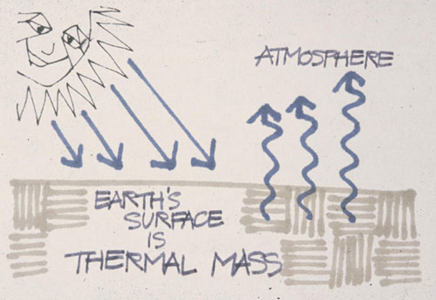
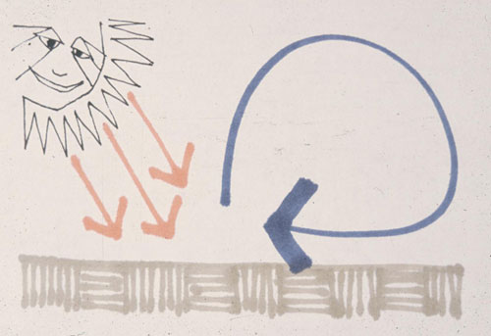
Heating application of thermal mass is to select material(s) that will absorb heat from solar exposure during the day, hold that heat for a time during non-solar periods, then give it up as conditions warrant. The same action can be incorporated for building cooling.
As an area heats up, heat can be absorbed into the thermal mass material, then held until evening time where effective cooling practices using cross ventilation, night sky radiation and even whole house mechanical ventilation. This action is based upon fundamental principles of thermal transfer.

Slide 26
Heat migrates to cold, so in a building, hot walls will radiate into cold spaces, and conversely, hot, summertime spaces will have their heat migrate to cooler walls.

Slide 27
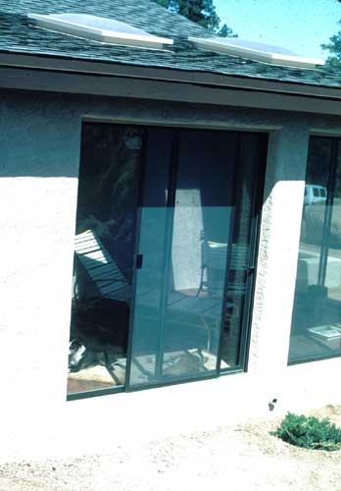
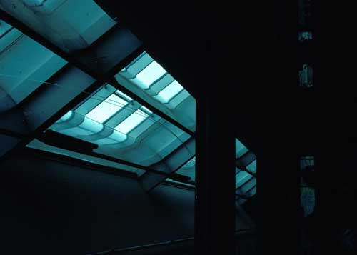
WINDOWS - It’s the clear thing.

Slide 28
One of the major design considerations affecting a building’s energy consumption is the location and size of windows. Windows are the weakest point of the building envelope. A square foot of glass will lose 12 times more energy than a wood wall with insulation.
As a rule, windows should be located primarily on the south side where they can be used as part of the heating system, as well as provide for natural lighting. East and west sides of desert buildings should have minimal or no windows since these are the two worst exposures for early morning and late afternoon summer sun.

Slide 29
Clerestorey windows are a design tool for getting sunlight benefits to areas not able to be located at the south face. Clerestories also provide a mechanism for diffusing the direct impact of sunlight and moderating glare. Additionally, operable clerestorey windows are a good device for house ventilation cooling in the summer.
Reverse clerestories, those opening to the north can be a benefit in desert conditions . Facing north, they provide even natural light to interiors and their angled backs can be a perfect mounting structure and angle for solar equipment like photovoltaic and solar water heating panels.

Slide 30
THERMAL DECOMPRESSION - It’s the healthy thing
A building trying to maintain a comfortable internal temperature will always be in conflict with the temperatures adjacent to the exterior. Heat always moves to cold - in the winter , interior warmth is moving toward the exterior cold. In the summer, the external heat is trying to move to the interior coolness. The greater the difference in temperature between inside and outside conditions, the faster the movement of heat and the greater the amount of heat moved, and the more equipment is required to mitigate conditions.
Thermal decompression simply means that there is layering of vegetation, landscape features, and built elements that gradually temper the environment to a point where the temperatures adjacent to the building are much closer to its internal temperature. This decompression approach establishes a condition where the difference between the internal temperature and the temperature on the building skin are much closer, so less heat is gained (or lost).

Slide 31
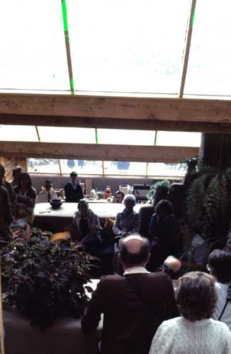
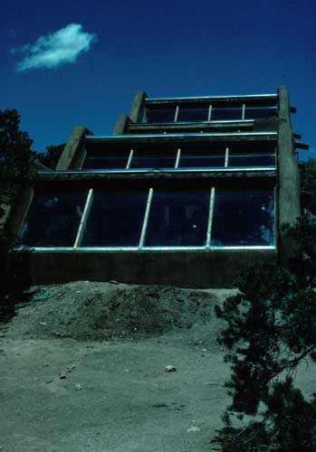
PASSIVE SOLAR APPLICATIONS - It’s first thing
Natural Lighting -
The sun’s capacity to provide light means no need to use artificial lighting during the day. Solar building design incorporates day lighting strategies of letting light into all spaces either directly with proper window placement, clerestories and even skylights, or indirectly with light reflecting color choices, light shelves, and transparent and translucent walls.
This glazing has dual benefit - while providing for illumination, it can also provide for wintertime heating. Good passive design then incorporates both attributes of sunlight - illumination and heating, and the building construction and finishes are used to capitalize on both.

Slide 32
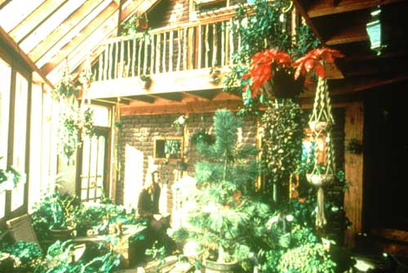
HEATING/COOLING
Basics of passive applications are rooted in dealing with the sun (exposure to and capture of the sun’s energy when we want heat; protection from the sun when we want cooling), the materials used (for effective capture, storage, and use), and natural processes of physics for both).

Slide 33
Every passive system for solar heating requires exposure to the sunlight and trapping it - this is done by glazing - windows for a building and glass covers for solar panels.
Every passive system is dependent upon materials which will absorb the sun’s heat, store a good quantity of it and easily distribute it. In a building, the effective material can be the structure itself, in the form of thermal mass.

Slide 34
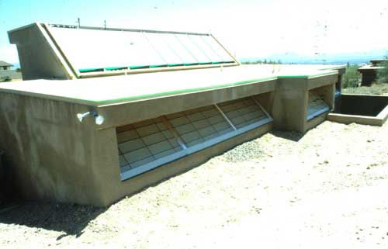
Heat capture, storage and distribution follow a natural and predictable behavior. Sunlight heats the surfaces it strikes.
The amount of heat held within the material depends on the material composition - straw is a terrible holder, concrete is a better holder. When sunlight is no longer available the material gives its’ captured heat to adjacent cooler conditions.

Slide 35
Generally there are 3 passive heating building concepts - Direct Gain, Indirect Gain and Isolated Gain These concepts have inherent within them cooling strategies and applications as well.

Slide 36
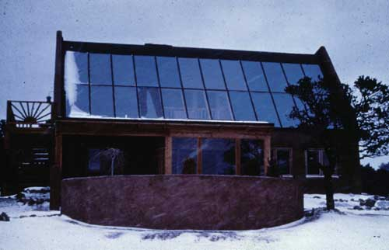
Direct Gain -
Simply stated, sunlight comes directly through windows into the space to be heated.

Slide 37
The building materials struck by the sunlight are thermal mass materials - concrete/tile floor, masonry walls, or even strategically placed containers of water.
Building windows act in exactly the same way as solar panel glazing - they let the sunlight (short wave radiation) in and inhibit heat (long wave radiation) from escape.
Like any system, optimization is the goal - so the building eaves and overhangs become a designed-in optimizing element - summertime conditions are mitigated by keeping the sunlight off of the windows, while in the winter, the sun is much lower in the sky and can easily skirt under the building’s brow.

Slide 38
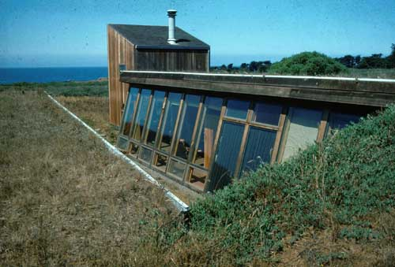
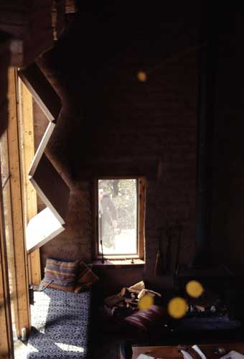

Slide 39
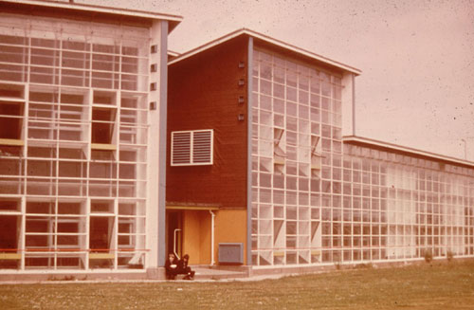
Heating is quite simple in this approach - sunlight, absorbed by the thermal mass materials, is stored as heat. When the space cools in the evening, the heat migrates to the cooling spaces directly (radiation) or by air movement across the surface of the material (convection).
This system has worked effectively in Arizona designs, as well as that sunniest of place of Liverpool, England.

Slide 40
For effective cooling, Direct Gain Avoidance is the rule, BUT the thermal mass of the building can still be used in the cooling cycle. The materials, by nature of their thermal mass attribute, remain cool. This coolness allows their absorption of unwanted heat in the building - acting as a sort of thermal sponge, moving heat away from people and holding to the evening, where cross ventilation or even whole house fans can dispose of the captured heat.
Control of Direct Gain systems is done with the addition of movable insulation, either on the exterior or with interior blinds, and cross ventilation planning with placement of low wall vents on the cool side of the building, and high wall vents on the warm side of the building.

Slide 41
Indirect Gain -
Sunlight penetrates south facing windows, then strikes thermal mass located behind the window and between the sun and living space. There are basically three types of indirect gain systems, each defined by where the thermal mass is located.
Thermal Wall and Plenum
Sunspace
Thermal Roof

Slide 42
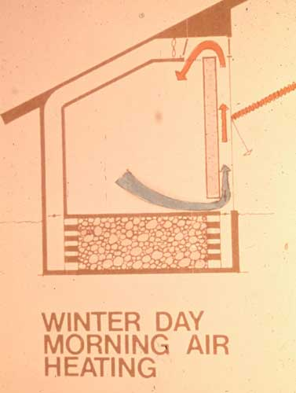
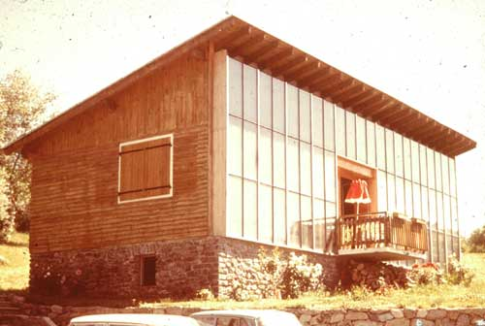
Thermal Wall and Plenum -

Slide 43
South facing windows front a thermal mass wall of masonry, and/or water, placed directly behind to create a vertical plenum or chase. This mass absorbs, stores and distributes heat. Sunlight passes through the glass and converts to heat energy as it impacts the thermal mass and is absorbed, slowly saturating or moving through the mass until it radiates into the living space - the wall is a delayed action radiator.
At the same time the addition of vents at the top and bottom of the wall allow for direct passive heating. Warmed air between the glass and the wall spills into the living space through the opened upper vent and cooler room air enters the plenum through the bottom vent, and is heated by the sun warmed wall, rises, spills into the room and is replaced by cooler air again, and this natural convection process continues as long as there is sunlight.

Slide 44
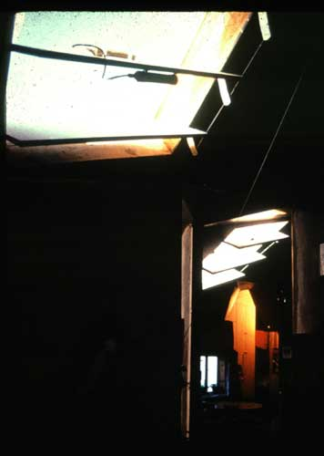
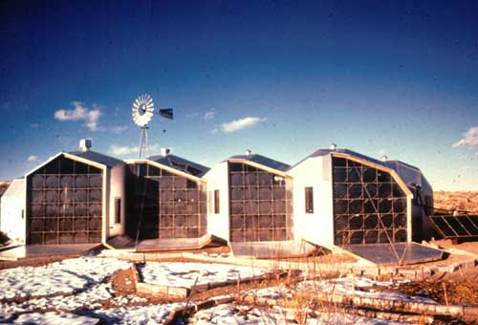

Slide 45
Sunspaces are a combination of Direct Gain and Thermal Wall systems, utilizing both approaches in tandem with a dedicated Direct Gain area (Sunspace) adjacent to the living space, with a Thermal Wall placed between the two.
The Sunspace, has extensive south glazing and large daily fluctuations, while the adjacent living space is protected from these fluctuations by the Thermal Wall separating the spaces. Vents or operable doors and windows in the Thermal Wall allow warmed Sunspace heat to circulate to adjacent living spaces by natural convective actions during the day, and radiate the absorbed Sunspace heat to the living spaces in the evening..

Slide 46
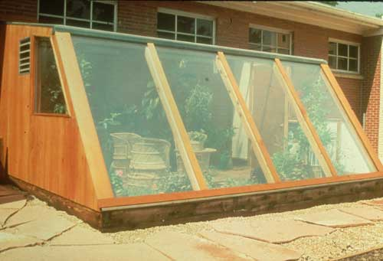
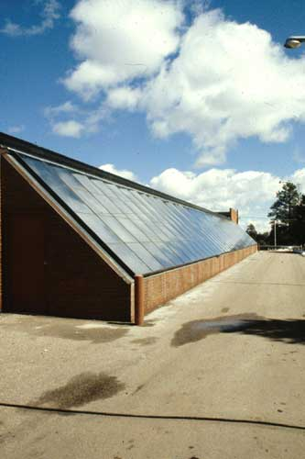
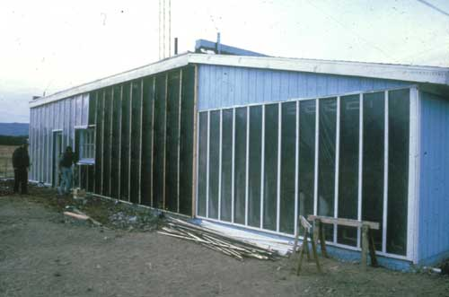
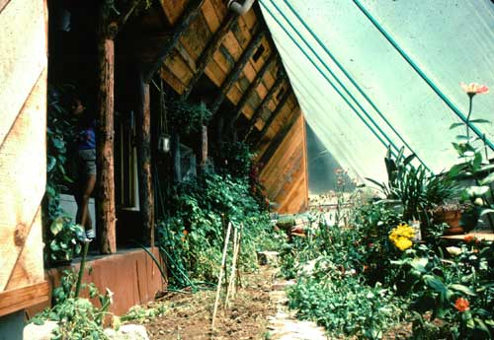
Sunspaces - green houses:

Slide 47
Thermal Roof -
The thermal Roof approach places thermal mass on the roof rather than at a wall. The system is both a radiator and an absorber and replaces standard heating and cooling mechanical and distribution systems.
Using water as thermal mass, roof ponds are constructed directly on top of heat conducting ceilings of metal pans or metal decking so there is direct thermal transfer. Movable insulation is placed above the ponds to facilitate retention of heat in the winter and to prevent absorption of external heat in the summer.

Slide 48
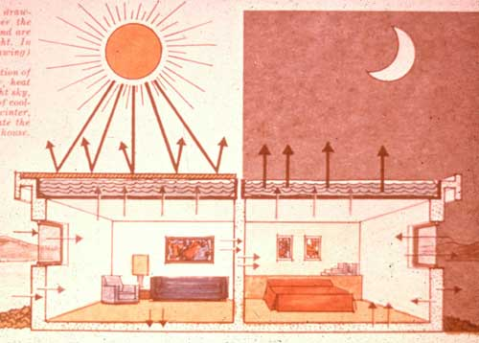
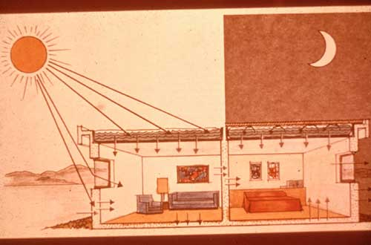
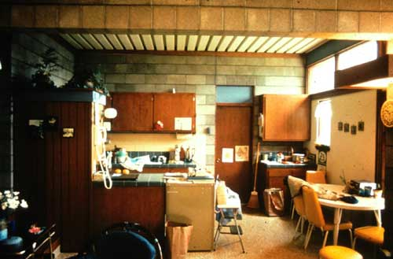
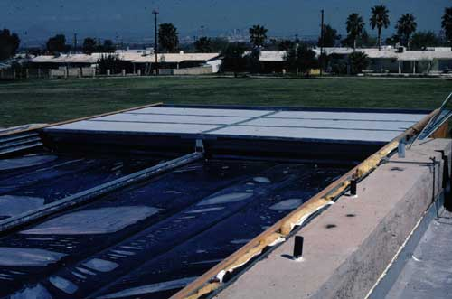
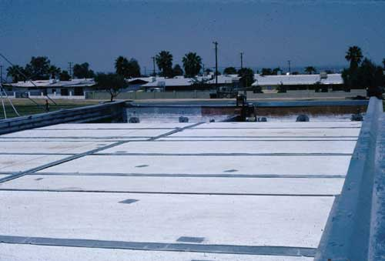

Slide 49
During wintertime conditions, insulating panels are rolled back, exposing water contained in UV inhibiting water beds to the sun. The ponds gather the sun’s warmth and at nightfall, the insulating panels are replaced to contain the gained heat and prevent loss to the cold night air.
The heat stored in the bags, warms the supporting metal decking and the entire ceiling is a radiant ceiling throughout the cold winter night. The next morning, the insulating panels are removed when the sun appears and the cycle begins again.

Slide 50
Summer cooling is a reverse process. Ponds, covered during the daytime heat, remain cool and act in concert with the supporting metal ceilings as a thermal sponge absorbing interior heat generated from people, equipment, and infiltration from the outside.
At night, panels are removed and the ponds throw off their gathered heat to the night sky by means of radiation, convections, and if wet down, by evaporation.

Slide 51
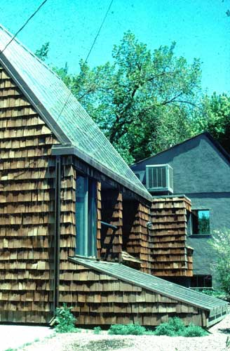
Isolated Gain -
This is basically an indirect system where solar collection for heating are isolated from the living spaces, and while the system functions independently, heating can be called for by simply opening some floor vents and letting the natural behavior of hot air rise through the spaces. A heat transfer material of air or water, is moved across a collector panel system facing the sun, and circulated into a tank surrounded by rock (water transfer system) or a rock bin (air transfer system) in a continuous operating loop. Natural thermosiphoning occurs when the collector is lower than the heat storage area which is usually located under the building.

Slide 52
A hybrid of this system can include moving heated water or air through a radiant floor system where the masonry floor itself acts as the thermal mass storage. This variation can also use cool water to create a “cool” floor by running house supply water, or water from an adjacent pool, through a floor system.

Slide 53
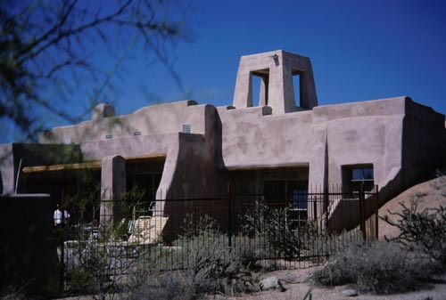
Cool Towers -
Evaporative cooling systems which utilize gravity effect on dense, cooled air to drop and spill into living spaces. The system is comprised of wet cooler pads mounted high in an area which provides no obstructions to air movement, which comes into contact with the pads.
The warm dry air contacting the wet pads, cool and becomes more dense and heavier and falls down the tower, usually positioned over or adjacent to a major living space. The falling cool air, spills into the living space, pushing warmer out at strategic venting areas.

Slide 54
A variation to this system is the addition of a south facing thermal chimney to pull cool tower air through the house. Located at an opposite location from the cool tower, the thermal chimney provides an escape vent for interior warm air , which moves more quickly as it get heated and is driven out.
This rapid venting has a drawing effect on the cool tower air and it is distributed more extensively through the building. The solar chimney can be set up to become a recirculating air heater during winter conditions.

Slide 55
Natural Cooling -
There are three sources of undesirable heat - direct summer sun solar gains through windows and glazing; heat transmission through the building envelope; and internal heat produced by people, their activities, and their equipment.
Direct solar heat gain at windows and glazing can be easily controlled by shading the house with external shading devices and vegetation as well as thermal insulating shutters.
Heat transmission conditions can be nullified by setting up layers of thermal decompression with vegetation, built structure like porches, and water features.
While there is not much that can be done to reduce natural heat production by people, equipment heat generation can be impacted by careful selection of energy efficient equipment and by good timing - do the laundry in the evening.

Slide 56
Passive Solar Energy has many faces and applications and an effective Passive solar building incorporates many of these elements. .

Slide 57

Passive solar energy is direct,
natural,
effective,
cost effective,
and inherent to the building form, structure, materials and use.

Slide 58
This presentation was originally constructed by the Arizona Solar Energy Association for the Arizona Solar Center, Inc. and was
revised in 2015.

